Slide 1
Federal Docket Management System (FDMS.gov)
Regulations.gov
Federal Register Liaison Conference
June 5, 2014

Slide 2

eRulemaking Program
eRulemaking Vision: Citizens can easily access and participate in a high quality, efficient, and open rulemaking process.
Scope: 37 Partner Departments and Agencies (175 Federal participating entities)
  Managing Partner: EPA (eRulemaking Program Management Office)
The Federal Docket Management System (FDMS) is a government-wide web-based system that provides agencies and the public with electronic access to the entire regulatory docket
  Public access: Regulations.gov
    Agency access: FDMS.gov (log-in required)
Notes:
Introduction
Federal Agencies have a similar regulatory process (notice and comment); however, the actual rule publication process within a federal agency can vary
Some agencies have centralized processes, some have distributed
Question to ask: Are there FR liaison officers who are also involved in/use FDMS and to what extent?

Slide 3






Where does eRulemaking fit in the rule publication process?
OFR publishes Federal Register rules and notices
Federal Docket Management System
Public:
View the FR and supporting information
Submit comments
Agencies:
Move the Federal Register document to a docket
Upload supporting documents
Review and post comments
FDSys
Office of Federal Register
Notes:
FDMS receives documents published from the Office of the Federal Register via the “FR Feed”
Each day Federal Register publishes rulemakings and notices. These are fed into FDMS using FDSys (Federal Digital System, operated by GPO)
Public can view Federal Registers immediately, and start submitting comments
Agencies move the Federal Registers to the appropriate docket and can start reviewing comments
NOTE: Dockets can be created in FDMS.gov prior to rule publication, so agencies can include the FDMS Docket ID number in the Federal Register document.

Slide 4
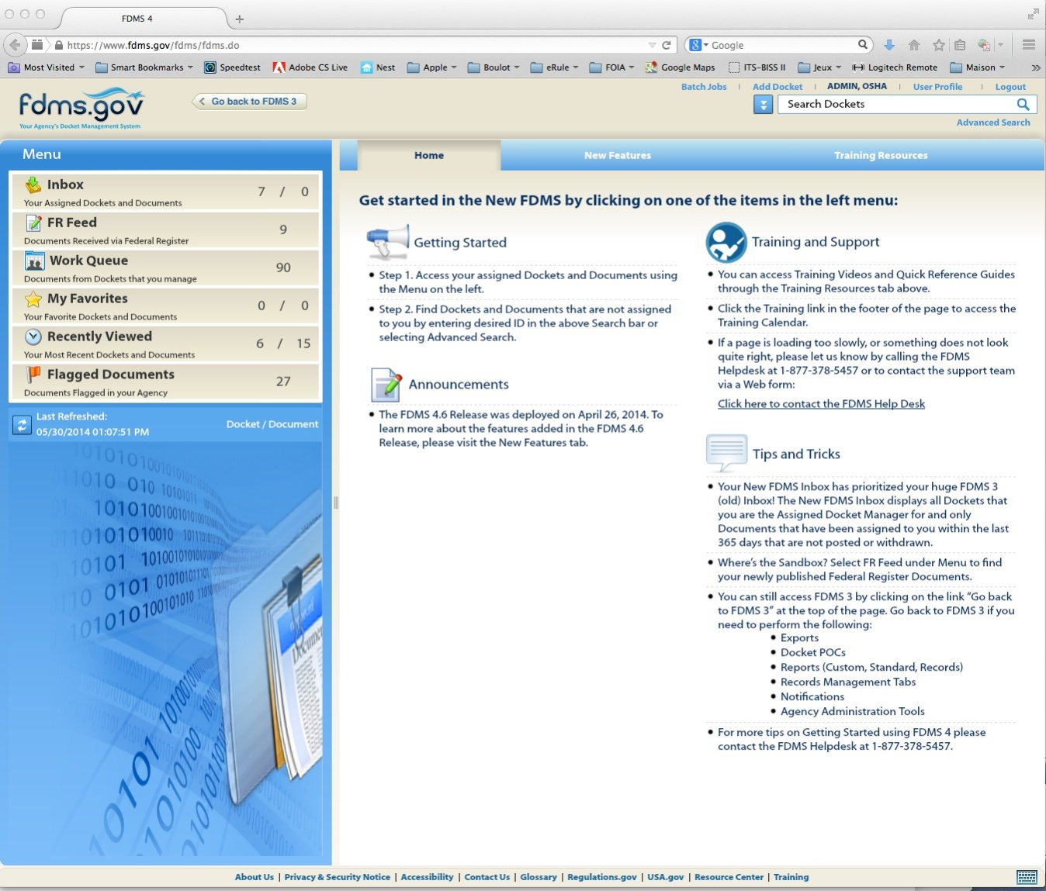
Federal Docket Management System (FDMS.gov)
For Agencies: Supports the federal regulatory process
  Dockets contain entire rulemaking lifecycle
  Comment management
Functionality
  Create and manage dockets
  Receive, review and post public comments
4
Notes:
Accommodates rulemaking and non-rulemaking actions
Rules, proposed rules
Notices
Supporting and background materials
Public comments and submissions
Other documents
Agencies administer different programs, comply with different statutes, and have different policies for making information available on Regulations.gov

Slide 5
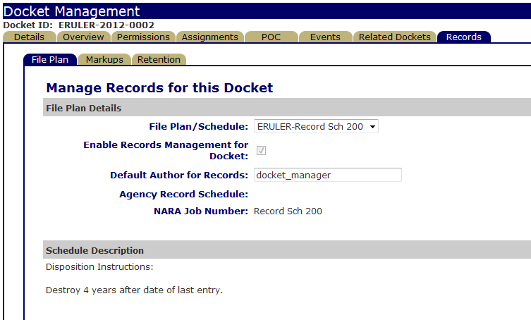
FDMS Features: Electronic Records
FDMS allows agencies to create, maintain, and properly manage records in an electronic system.
  Compliance with NARA policy and DOD 5015.2 standards
Each agency has it’s own set of record schedules (also known as File Plans) that define a period of time they plan to keep their documents before disposing of them.
Notes:
Benefits:
There is no additional cost to implement the FDMS Records functionality
Long term costs are decreased by migrating to an electronic tracking system and eliminating paper
The FDMS Records Module allows agencies to comply with government-wide record keeping policies:
Controlled access to secure documents. Access to Copyrighted, CBI, or PII information by specified users. Security and access controls are built in to FDMS RM via assigned roles and responsibilities.
Consistent policies and business rules. FDMS provides lifecycle management of all records in one system.
Easily locatable records for FOIA and Discovery requests.
Reduced risk of accidental destruction of documents.
Current records agencies:
ATBCB (Access Board)
CNCS
CPSC
EIB
EPA
FHWA
NARA
DOI

Slide 6
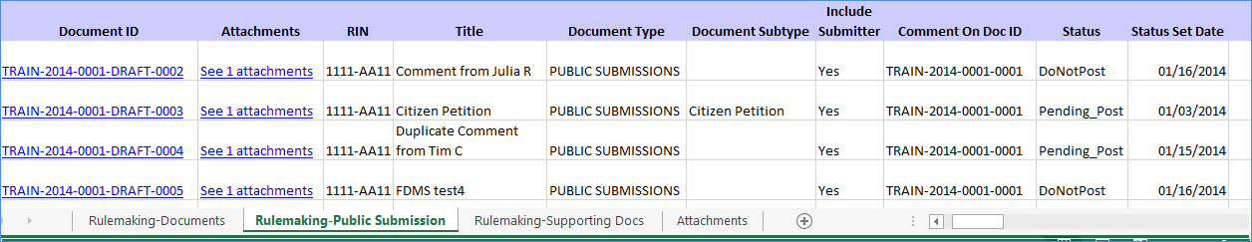
FDMS Features: Complete Docket Extracts
Agencies can download the entire docket (metadata and content files)
  Useful for comment management and review
Downloaded zip file includes:
  A folder containing the individual files and attachments associated with the bulk extracted documents.
  An Excel spreadsheet containing metadata fields and links to the content files.
Bulk Extract Spreadsheet

Slide 7
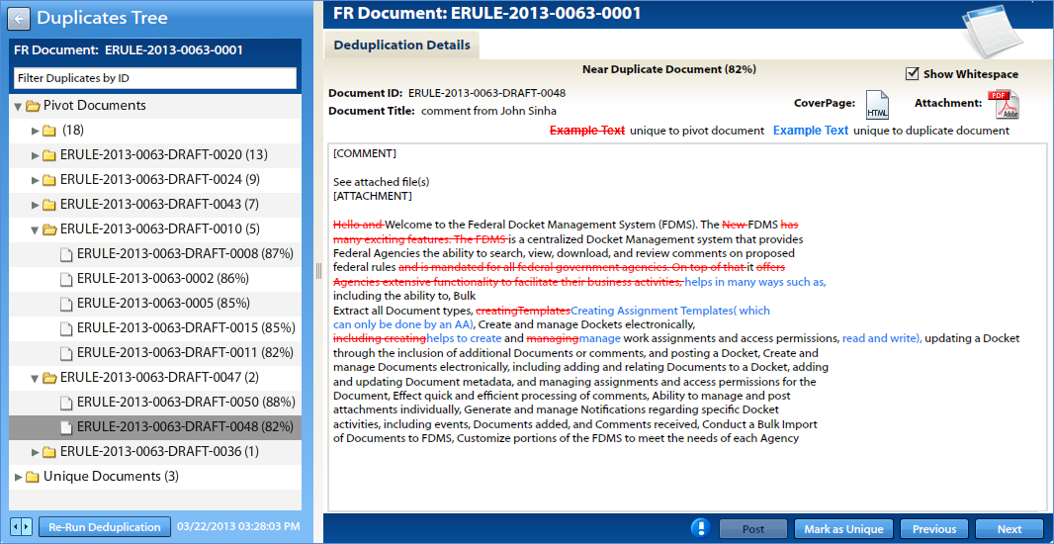
FDMS Features: Comment Deduplication Engine
The deduplication tool helps agencies review and process large numbers of comments in a timely and efficient manner by identifying mass mail campaigns
Users can easily view the content of each comment
Notes:
The Comment Deduplication engine allows Federal agency users to review comments faster and easier by:
Quickly identify mass mail campaigns and duplicate submissions from individuals and organizations
Detect the similarities and differences among comments within each campaign
How the comment deduplication engine works:
FDMS Beta uses a leading text analytics software technology (Content Analyst Analytical Tool, CAAT) that applies statistical capabilities to detect duplicate and near duplicate documents and text.
The deduplication engine can run on comments received via Regulations.gov on any Federal Register document (rule, proposed rule, notice) and comments manually uploaded into FDMS.
The deduplication engine evaluates web form comment text and the text contained in the first attachment of the comment (if available).
The engine selects a baseline document (defined as a pivot document) and matches comments that are at least 70% similar (default setting) to the base comment (the matches are defined as ‘near duplicate’ documents). The pivot document and associated near duplicates form a set of comments commonly referred to a “mass-mail campaign.”
Each set of comments is organized in a “Duplicates Tree” view with folders containing each set of comments. An assigned FDMS user can open each folder and click through to view the text of each near duplicate comment.
All unique documents (those comments that are not within 70% similar to any other comments) are individually listed in the document tree in the “Uniques” folder.

Slide 8
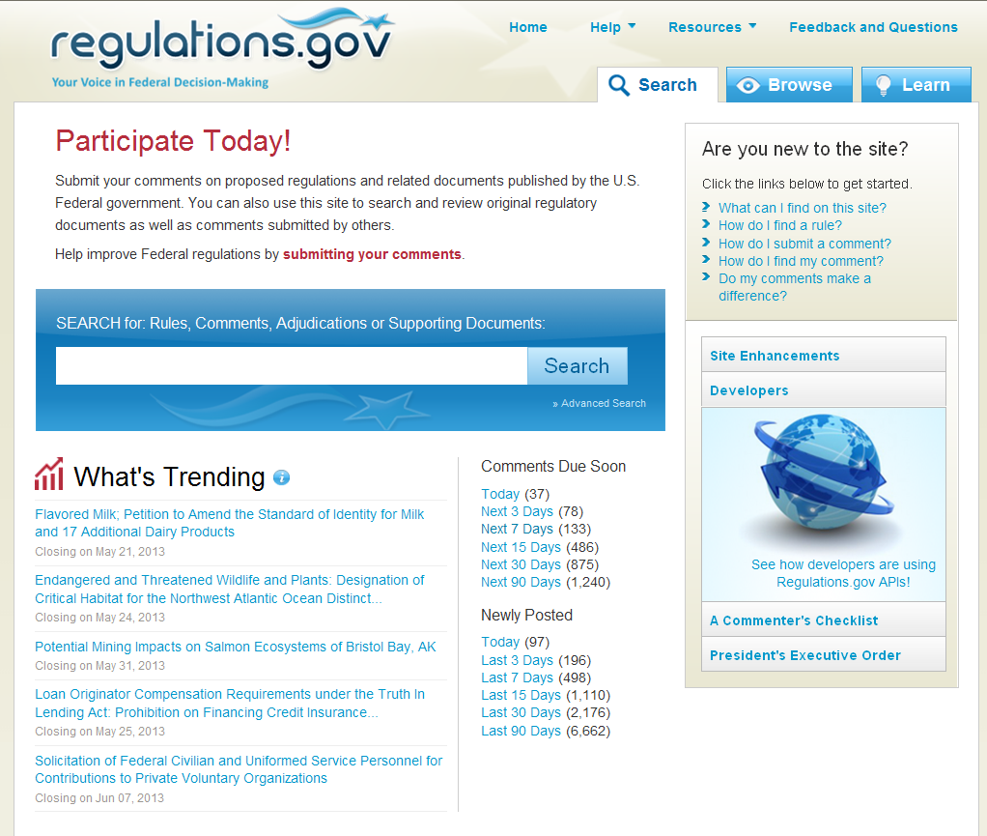
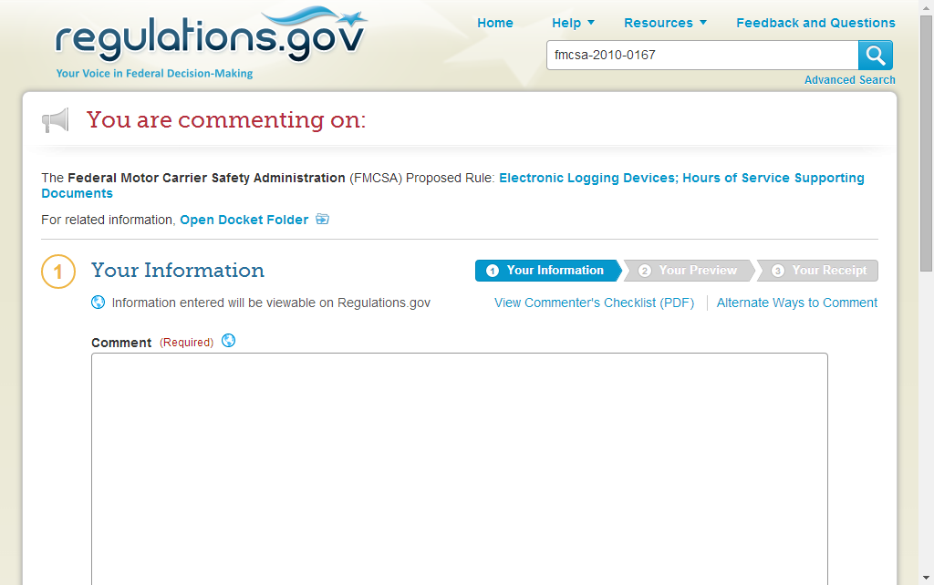
Regulations.gov
Public portal
  Access to the entire rulemaking lifecycle
  Web form to submit comments
Notes:
Public portal – to official federal rulemaking dockets
Users include general public, organizations, industry and regulated community, and government staff
Access to rulemaking information (and submit comments)

Slide 9

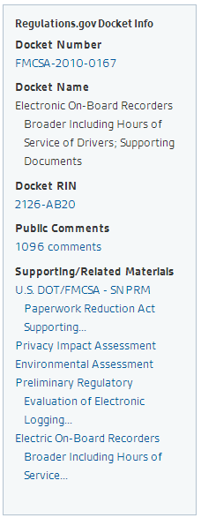
Regulations.gov features: Data APIs
Regulations.gov Data Application Programming Interfaces
  Document Search API -provides advanced search results.
  Document Information API - provides metadata associated with a specific Document.
  Docket Information API - provides metadata associated with a specific Docket.
FederalRegister.gov utilizes the Regulations.gov API to incorporate relevant docket information on article pages
Notes:
Note: Regulations.gov also uses FederalRegister.gov API for its Federal Register document text and images on the document details pages

Slide 10
New Features Coming Soon
More comment analysis functionality in FDMS.gov
  Comment Categorization
  PII and Vulgarity filters
Regulations.gov Comment API
  Collaborating with the Office of Federal Register on a comment form interface on FederalRegister.gov
Notes:
Timeframes:
Comment Analysis tools – late 2014/2015
Initial pilot on comment categorization functionality done with HHS
Regulations.gov comment form interface with Federalregister.gov – June 2014

Slide 11
eRulemaking Contacts
eRulemaking Program Management Office
Ed Cottrill, Director, 202-564-5002, cottrill.edward@epa.gov
  Valerie Brecher-Kovacevic, 202-564-2728, brecher-kovacevic.valerie@epa.gov
    ISO and eRulemaking Policy and Records Management
  Mike Whiting, 919-541-1125, whiting.michael@epa.gov
    IT Lead
  Holly Douglas, 202-564-8434, douglas.holly@epa.gov
    Budget Officer
  Kristin Tensuan, 202-566-1519, tensuan.kristin@epa.gov
    FDMS.gov
  Bryant Crowe, 202-566-0295, crowe.bryant@epa.gov
    Regulations.gov and FDMS Training
Notes:
Thank you to the Office of Federal Register for inviting us to this conference. We look forward to continued collaboration between the two organizations.
If any of the Federal Register liaisons attending this conference want to learn more about the program or how to be more involved in FDMS, please contact us directly!

