Slide 1
New Web Portal for
Digital (PKI) Submissions

Slide 2
What is PKI?
PKI stands for Public Key Infrastructure
For the purpose of the Federal Register, it allows agencies to submit documents digitally, and our office to verify the digital signature.
We accept the PKCS#7 format only

Slide 3
PKI and the
Federal Register
The digital signature must be applied by the person authorized to sign a document.
No longer need hardcopies, discs, disc certification letters, couriers, or mailings.
Submit your electronic file via our Web Portal.
Special handling letters and requests can still be made.
Publication timeframe remains the same.
DDH requirements remain: Only MS Word (.docx) files are acceptable. (No .pdf, .txt, etc)

Slide 5
Analysis of Documents Received for Past 4 years

Slide 6
Current CY14 PKI Statistics

Slide 7
Other Information
GPO Certificate Procurement: http://www.gpo.gov/projects/pki
GSA Signing tool: http://www.idmanagement.gov/documents/pkcs-7-document-signing-tool
  PKCS#7 Signing Tool Update, January 2015
    http://idmanagement.gov/product-testing-tools
Third party: check with your IT Department

Slide 8
Other Information cont.
OFR Web Portal: www.fedreg.gov
  The new web portal will go live on or about June 20, 2014
Questions? E-mail FedReg.Info@nara.gov
Aaron Woo, Office of the Federal Register, Director of Information Services and Technology
  Aaron.woo@nara.gov, awoo@gpo.gov

Slide 9
New Web Portal
Demonstration
Scheduled for launch mid-June
(Over the weekend starting June 20th)

Slide 10
Back-up Screenshots

Slide 11
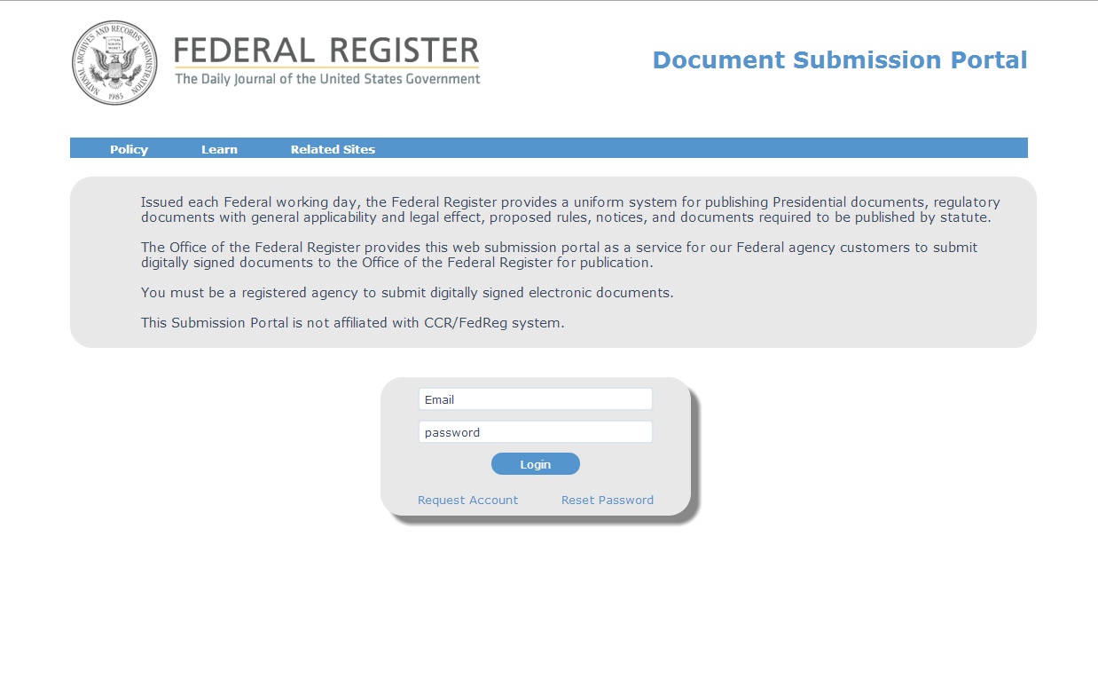
Web Portal Home Page

Slide 12
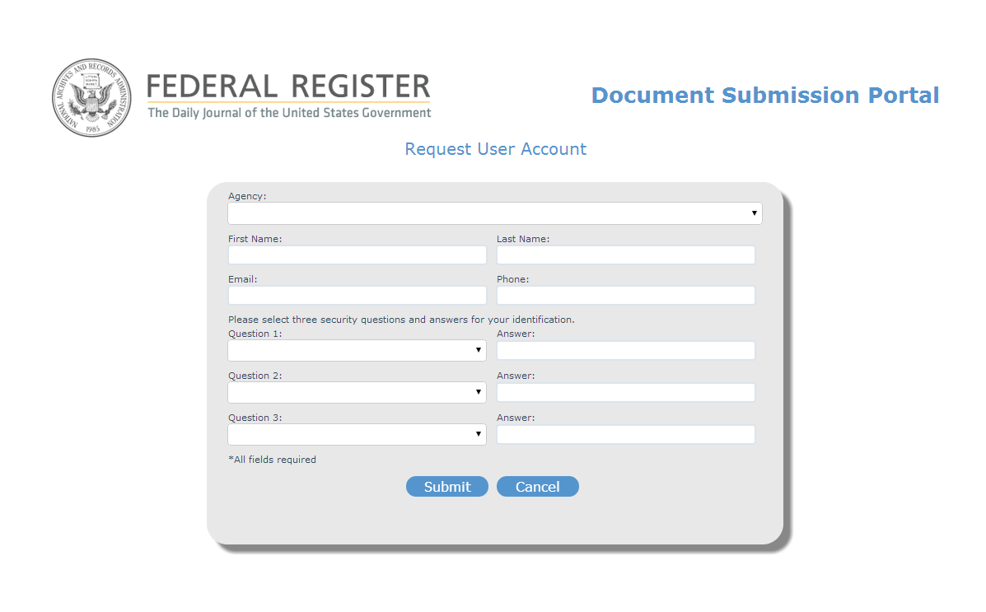
Request a User Account

Slide 13
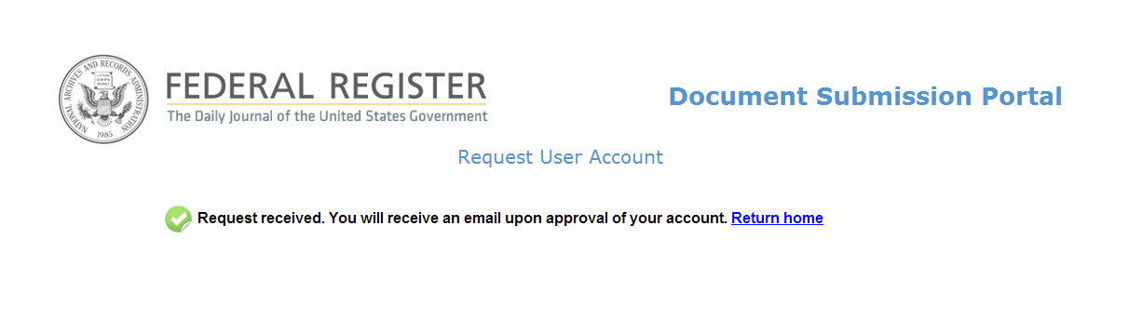
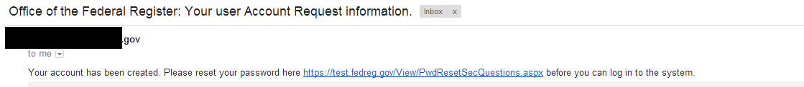
Confirm User Account

Slide 14
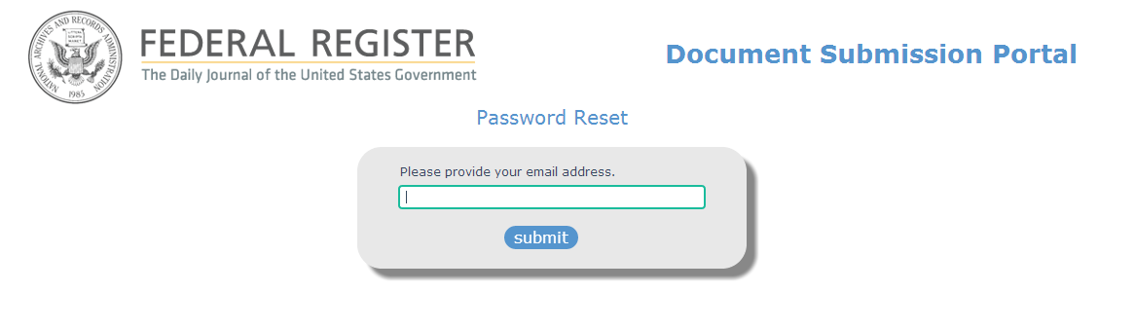
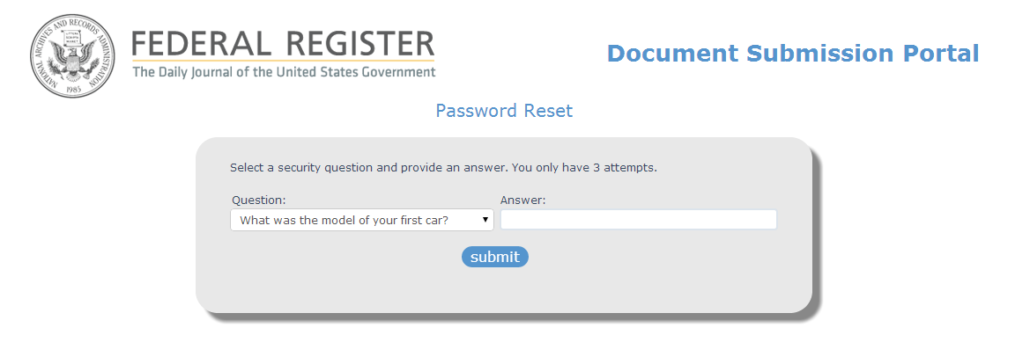
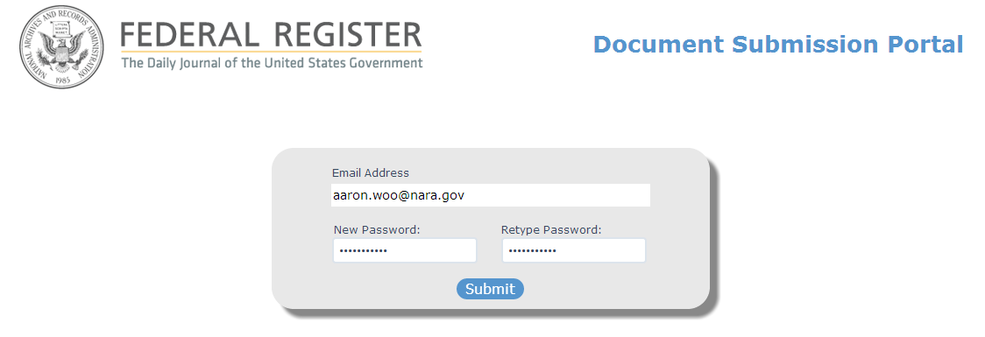
Establish Initial Password

Slide 15
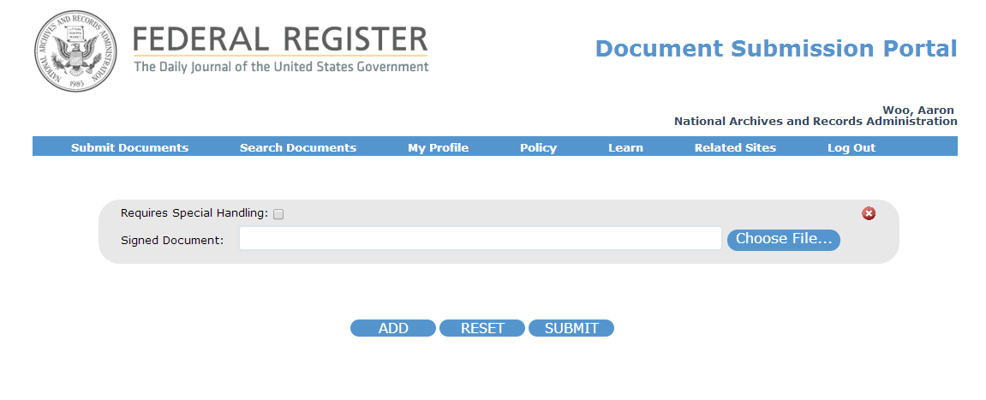
Landing Page /
Submit a Document

Slide 16
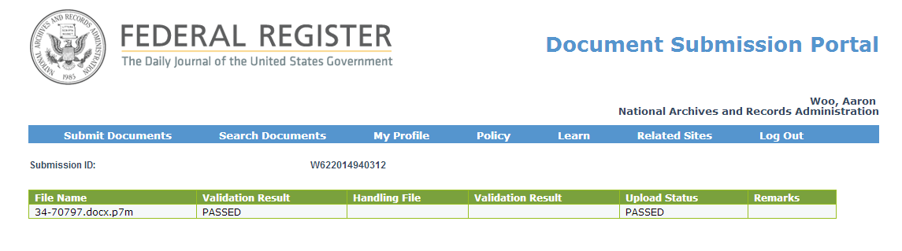
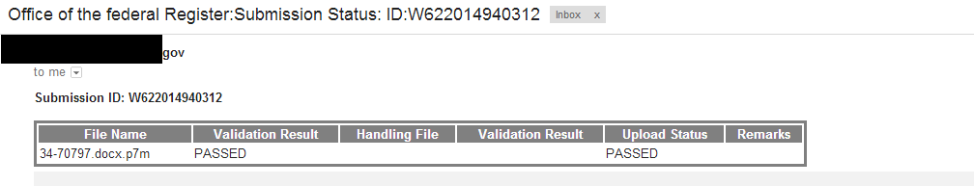
Completed Submission

Slide 17
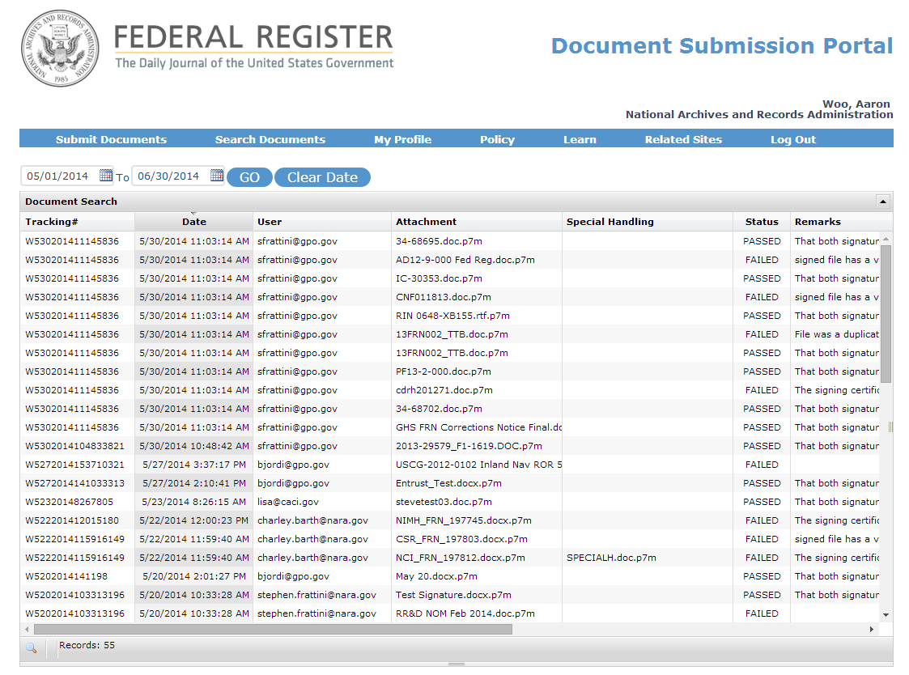
Search Documents

